Slide 1
The Decomposition of Databases™
@mhelmich – 07/20/2017
https://github.com/mhelmich/carbon-copy

Slide 2
Databases are Magicians
“Magic seems to break the laws of physics but it’s an illusion [… relational databases are magicians] Because they decouple ‘what you want’ from ‘how you get it’”*1
The core illusion relational databases entertain us with is that we actually don’t know how and where the data is stored
And we don’t need to know in order to retrieve data
*1 https://medium.com/salesforce-engineering/the-architecture-files-ep-4-the-database-is-a-magician-b951945ea5b8
Notes:
They are for at least three reasons:
They make us think we’re the only ones using them
They provide us with ACID
They decouple the “what you want” from “how to get it”

Slide 3
A History Lesson
Data was structured in a hierarchical way
Imagine this much like a JSON file
Code would read like a description of how to get the data you want
Until Dr. Frank Codd came around
Combining set theory and graph theory to propose a declarative way of describing ”the data you want”
https://en.wikipedia.org/wiki/Edgar_F._Codd#/media/File:Edgar_F_Codd.jpg
Notes:
Back in the 60s databases were flat files with a hierarchy
Example with bands and venues
But IBM didn’t want it, a few years later a young lad named Larry Ellison picked up the idea, rebranded it to SQL, and the rest is history

Slide 4
Recap: How do databases work again?
App
Buffer Cache
Query Engine
Data Files
Redo Log
Notes:
Query engine does the heavy lifting of translating the description of the data you want to a set of instructions to get the data
Obviously relational databases aren’t everything…

Slide 5
The Decomposition of Databases
App
Redis
Cache
DB
HBase
Kafka
Event Log

Slide 6
The Decomposition of Databases
App
Redis Cache
DB
HBase
Kafka
Event Log
https://apigee.com/about/blog/technology/nosql-noproblem-mapping-your-sql-thinking-nosql
Notes:
And if you don’t think that’s important then I invite you to read the actual code snippet for accessing redis…

Slide 7
The Decomposition of Databases
Jedis jedis = new Jedis(); Map<String, Double> scores = new HashMap<>(); scores.put("PlayerOne", 3000.0); scores.put("PlayerTwo", 1500.0); scores.put("PlayerThree", 8200.0); scores.keySet().forEach(player -> { jedis.zadd("ranking", scores.get(player), player); }); String player = jedis.zrevrange("ranking", 0, 1).iterator().next(); long rank = jedis.zrevrank("ranking", "PlayerOne");
http://www.baeldung.com/jedis-java-redis-client-library

Slide 8
The Decomposition of Databases
player | score
PlayerOne | 3000.0
PlayerTwo | 1500.0
PlayerThree | 8200.0
SELECT player FROM ranking ORDER BY score LIMIT 1;
SELECT ROWNUMBER() FROM ranking WHERE name = ‘PlayerOne’ ORDER BY score;

Slide 9
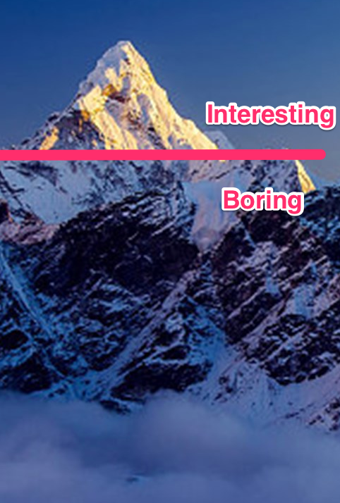
Enter Carbon Copy
An in-memory cache that speaks SQL
Tell me “what you want” not “how to get it”
Ships with its own JDBC driver
Based on two design concepts
Data placement
Minimum coordination
Notes:
SQL planning and optimizing for short and fast access paths
What I’m suggesting is a landscape that looks like this…

Slide 10
The Decomposition of Databases
App
Carbon Copy
DB
Phoenix
Kafka
Event Log
https://cdn.codementor.io/assets/topic/category_header/sql-5850f823f464b56f4c150db67dae5081.png

Slide 11
Carbon Copy
Talks JDBC with a client
Calcite providing JDBC interface, query planning in a box
Carbon Copy building complex data structures, managing data placement and query distribution
Galaxy providing a consistency framework for byte[]
Apache Calcite
Carbon Copy
Galaxy
Manages consistency
of byte arrays

Slide 12
Behind the Scenes Byte Arrays to distributed Indexes
Started with byte[]
DataBlock is the simplest data structure
Just 32kb long linked lists in a byte array
DataBlocks are composing complex data structures
Like hashes and btrees and tables and indexes

Slide 13
Behind the Scenes Distributed BTrees
Two fundamental design principles explained
Minimum coordination
Data placement
Code is moved to data
http://highscalability.com/blog/2012/8/20/the-performance-of-distributed-data-structures-running-on-a.html
Notes:
add an example on how insertion works and how it's optimized...or what it's optimized for :D

Slide 14
Next Up
Performance and scalability
Feed the query optimizer
Collecting stats
Data sampling
Monitoring
Automatic generation of indexes based on usage patterns

Slide 15
Thank you!
Fork me on github: https://github.com/mhelmich/carbon-copy
Questions?

